Slide 1



FROM BCBA TO
ETHICAL
BUSINESS OWNER
Navigating the Journey from Practice to Profit

Slide 2

Who is this presentation for?
BCBAs WHO ARE
CURIOUS ABOUT STARTING THEIR OWN PRACTICE
INTERESTED TO KNOW WHAT IS NEEDED

Slide 3

ESSENTIAL QUESTIONS
WHAT IS MOTIVATING YOUR DECISION TO START A BUSINESS?
WHAT WILL SUCCESS LOOK LIKE FOR YOU?
WHAT ASPECTS OF THE JOB / INDUSTRY DO YOU LIKE AND DISLIKE?

Slide 4



CONSIDER YOUR MOTIVATION
Fed up with practices who put profit over quality
Want more control
over time & pay
Sees industry turmoil and want more security

Slide 5

WHAT WOULD YOU DO?
A REAL-WORLD INSURANCE CHALLENGE

Slide 6
Little Timmy’s Insurance Case
INSURANCE FLIP-FLOP
AS THE BUSINESS OWNER,
  Originally on Mom’s BCBS insurance in April.
  Mom lost job, Timmy switched to Dad’s United insurance.
  August: Mom gets new job. Timmy now on Aetna
  You are unaware of the insurance flip flop.
  You submit a claim to BCBS and the claim gets rejected.
  You must now resubmit and start over.

Slide 7
TIMMY IS ONLY ONE OF YOUR CLIENTS
YOU HAVE 20 OTHERS TO SERVE

Slide 8
WHAT WOULD YOU DO?
OPTION 1
OPTION 2
OPTION 3
You personally spend time on the phone with insurance to solve the problem.
Ethical - but slows you down
Hand it off to a newly hired intern and resolve the situation.
Could work, but puts the intern in a tough spot
Discharge Timmy so you don’t have to deal with it.
Fastest solution, but unethical

Slide 9
WHAT WOULD YOU DO?
A REAL-WORLD MARKETING CHALLENGE

Slide 10
The Great Success Story Spin
AS THE BUSINESS OWNER,
THE DILEMMA
  You need to attract more clients to grow the practice.
  You invest in targeted online marketing.
  The ads emphasize success rates and client testimonials.
  Selective data is used to paint a more favorable picture.
  Testimonials don’t reflect the full spectrum of client experience.
  Success rates don’t provide context.

Slide 11
BUT YOU NEED MORE CLIENTS…
YOU HAVE 5 EMPLOYEES TO KEEP HAPPY

Slide 12
WHAT WOULD YOU DO?
OPTION 1
OPTION 2
OPTION 3
You present an accurate and transparent picture.
Ethical - but slows your growth…
You ignore the inaccuracies, believing it’s common practice to highlight the best outcomes.
Could work in the short term, but harm reputation in the long run
You avoid and refocus on word-of-mouth referrals or community events.
Avoids confronting ethical issue, but leaves content out there. Harming reputation

Slide 13
Why are there so many unethical business owners?
OWNING A BUSINESS IS HARD.
YOU WILL HAVE TO MAKE TOUGH DECISIONS AND DEPEND ON A QUALIFIED TEAM.
IT REQUIRES: TIME, MONEY, AND EXPERTISE.

Slide 14

THIS IS NOT A JUSTIFICATION FOR CRUMMY BEHAVIOR.
YOU SHOULD, HOWEVER:
UNDERSTAND THERE’S A LOT TO CONSIDER
KNOW THAT ALL PROBLEMS ARE FIXABLE
ACCEPT THAT PROBLEMS REQUIRE MONEY, TIME, AND STAFF TO FIX EFFICIENTLY WHILE STILL OPERATING IN AN ETHICAL MANNER
IT’S NOT ABOUT SHORT-TERM GAINS. BUILDING TRUST TAKES TIME.

Slide 15

REALITY CHECK
SURVIVAL RATE
TIME COMMITMENT
  20% OF SMALL BUSINESSES FAIL WITHIN 1ST YEAR
  50% FAIL WITHIN 5
  REQUIRES SUBSTANTIAL TIME INVESTMENT
  LONG HOURS, ESPECIALLY IN INITIAL STAGE
KNOW WHAT YOU’RE GETTING INTO
FINANCIAL RISK
LEGAL COMPLIANCE
  INITIAL INVESTMENT
  OPERATIONAL EXPENSES
  POTENTIAL LIABILITIES
  LAWS AND REGULATIONS
  DATA PRIVACY
  INSURANCE REQUIREMENTS

Slide 16

TRAITS OF A SUCCESSFUL OWNER
VISIONARY LEADERSHIP
THEY HAVE A CLEAR VISION AND INSPIRE OTHERS TO WORK TOWARD COMMON GOALS

Slide 17

TRAITS OF A SUCCESSFUL OWNER
RESILIENCE
THEY BOUNCE BACK FROM SETBACKS, LEARN FROM FAILURES, AND USE CHALLENGES AS OPPORTUNITIES FOR GROWTH

Slide 18
LEADERSHIP & RESILIENCE
YOU MAY BE ABLE TO MANAGE MOST THINGS
BY YOURSELF IN THE BEGINNING (WITH ~5 CLIENTS)
BUT, WHAT WILL THAT LOOK LIKE WHEN YOU HAVE 20? 30?
YOUR AVAILABILITY FOR CLINICAL HOURS DECREASES AS YOU GROW
WHAT WILL SUCCESS LOOK LIKE FOR YOU?

Slide 19

TRAITS OF A SUCCESSFUL OWNER
ADAPTABILITY
THEY EMBRACE CHANGE, STAY FLEXIBLE, AND QUICKLY ADJUST TO NEW MARKET CONDITIONS AND TECHNOLOGIES

Slide 20

TRAITS OF A SUCCESSFUL OWNER
PASSION
THEY ARE DEEPLY PASSIONATE ABOUT THEIR BUSINESS, DRIVING THEIR DETERMINATION AND COMMITMENT TO SUCCESS

Slide 21
ADAPTABILITY & PASSION
“I DON’T GET TO DO THE THERAPY ANY MORE.
I’M DROWNING IN PAPERWORK. I MISS THE KIDS.”
“I FEEL LIKE AN ADULT BABYSITTER. I’M CONSTANTLY HAVING TO DISCIPLINE RBTS FOR LAST MINUTE CALL-OUTS AND NOT DOING THEIR SESSION NOTES.”
WHAT ASPECTS OF THE JOB / INDUSTRY DO YOU LIKE AND DISLIKE?

Slide 22

TRAITS OF A SUCCESSFUL OWNER
CONTINUOUS LEARNING
THEY HAVE A GROWTH MINDSET, CONSTANTLY SEEKING NEW KNOWLEDGE AND SKILLS TO STAY AHEAD IN THEIR INDUSTRY

Slide 23

TRAITS OF A SUCCESSFUL OWNER
HUMILITY
THEY UNDERSTAND THAT THEY DON’T HAVE ALL THE ANSWERS AND ARE WILLING TO LEARN FROM THEIR TEAM, CUSTOMERS, AND MENTORS TO IMPROVE THEIR BUSINESS

Slide 24
CONTINUOUS LEARNING & HUMILITY
YOU DO HAVE OTHER OPTIONS!
ACCEPT THAT YOU WILL BE DOING THE ADMIN WORK BECAUSE YOUR TEAM WILL DEPEND ON YOU.
NO ONE CAN BE AN EXPERT IN EVERYTHING. HIRE TRUSTED EXPERTS TO ASSIST.
WHAT IS MOTIVATING YOUR DECISION TO START A BUSINESS?

Slide 25
How do your personal qualities align with these traits?
ARE YOU A LATERAL THINKER?
ARE YOU COMFORTABLE MAKING TOUGH DECISIONS?
ARE YOU A DEPENDABLE LEADER?

Slide 26
READY TO DIVE IN?
THE ROADMAP
HERE’S WHAT YOU NEED TO GET STARTED

Slide 27



THE 3 THINGS YOU NEED:
ATTRACT CLIENTS (Marketing)
SERVE CLIENTS PROPERLY (Credentialing)
BUILD A TEAM OF TRUSTED ADVISORS (Continual Improvement)

Slide 28


ATTRACT CLIENTS
You need a marketing plan to attract and retail clients.
Step 1: Find your referral sources.
HOW TO GET STARTED
Write down a list of your cheerleaders.
These are the people who can support your business by feeding you quality leads.

Slide 29


STEP 2: DO A SWOT ANALYSIS
What are your Strengths?
What are your Weaknesses?
Where are the Opportunities?
What are some Threats?
SET UP FOR SUCCESS
Be honest with yourself. If you really don’t enjoy something, don’t force it!
The SWOT is the basis of your unique selling points to clients.

Slide 30


STEP 3: DEFINE YOUR STORY
What sets you apart?
Why should someone trust you over another company?
How will you cut through the noise?
THIS IS YOUR BRAND BASIS
Business Name, Tagline
Logo, Colors, Fonts
Online presence (Website, social media)
Professional email address
Business Cards, Brochure

Slide 31

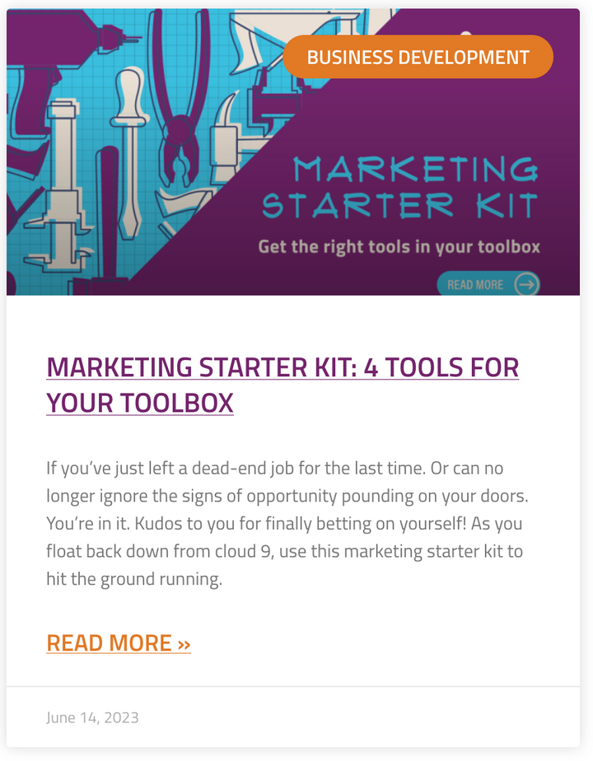
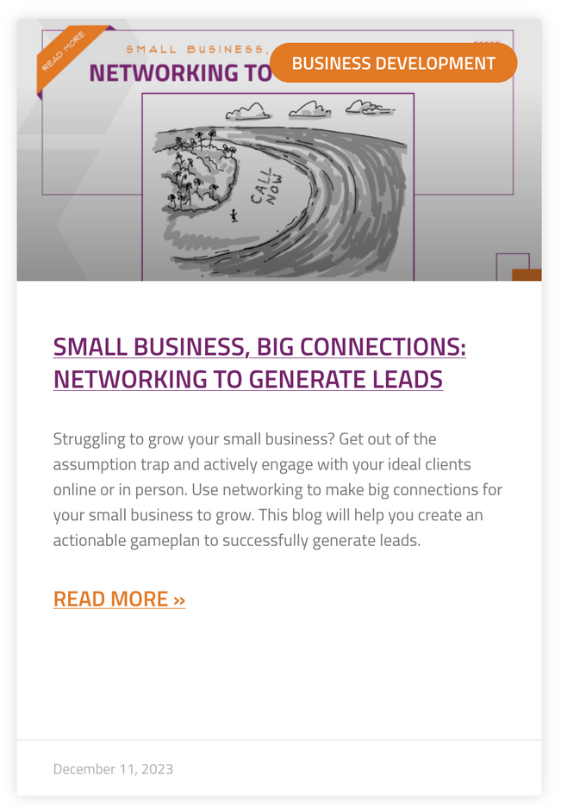
MARKETING RESOURCES!

Slide 32


MARKETING RESOURCES!

Slide 33
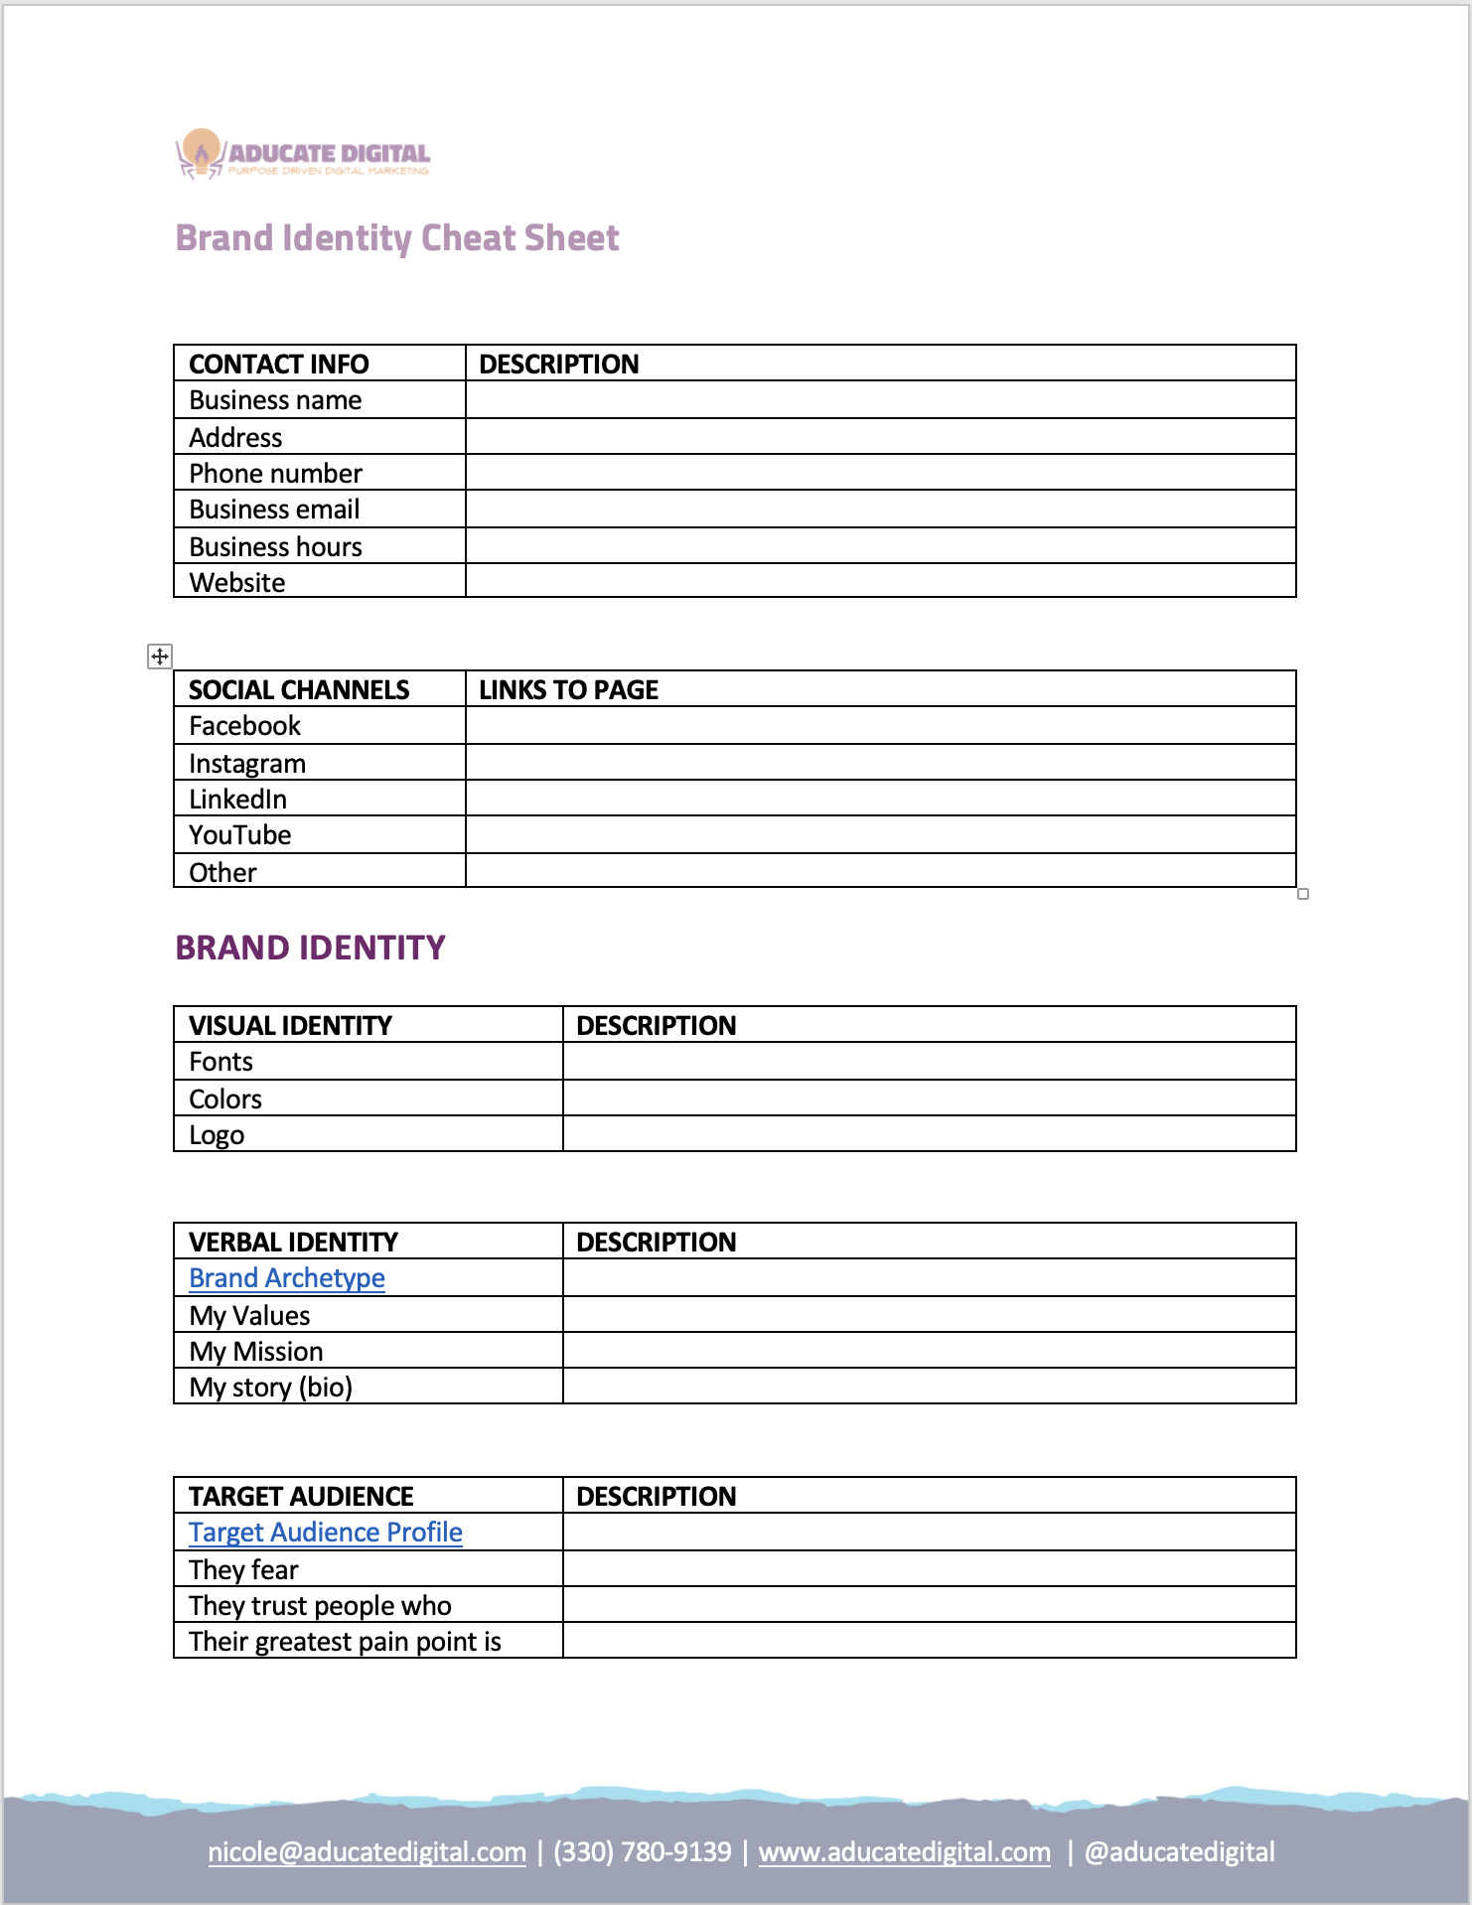
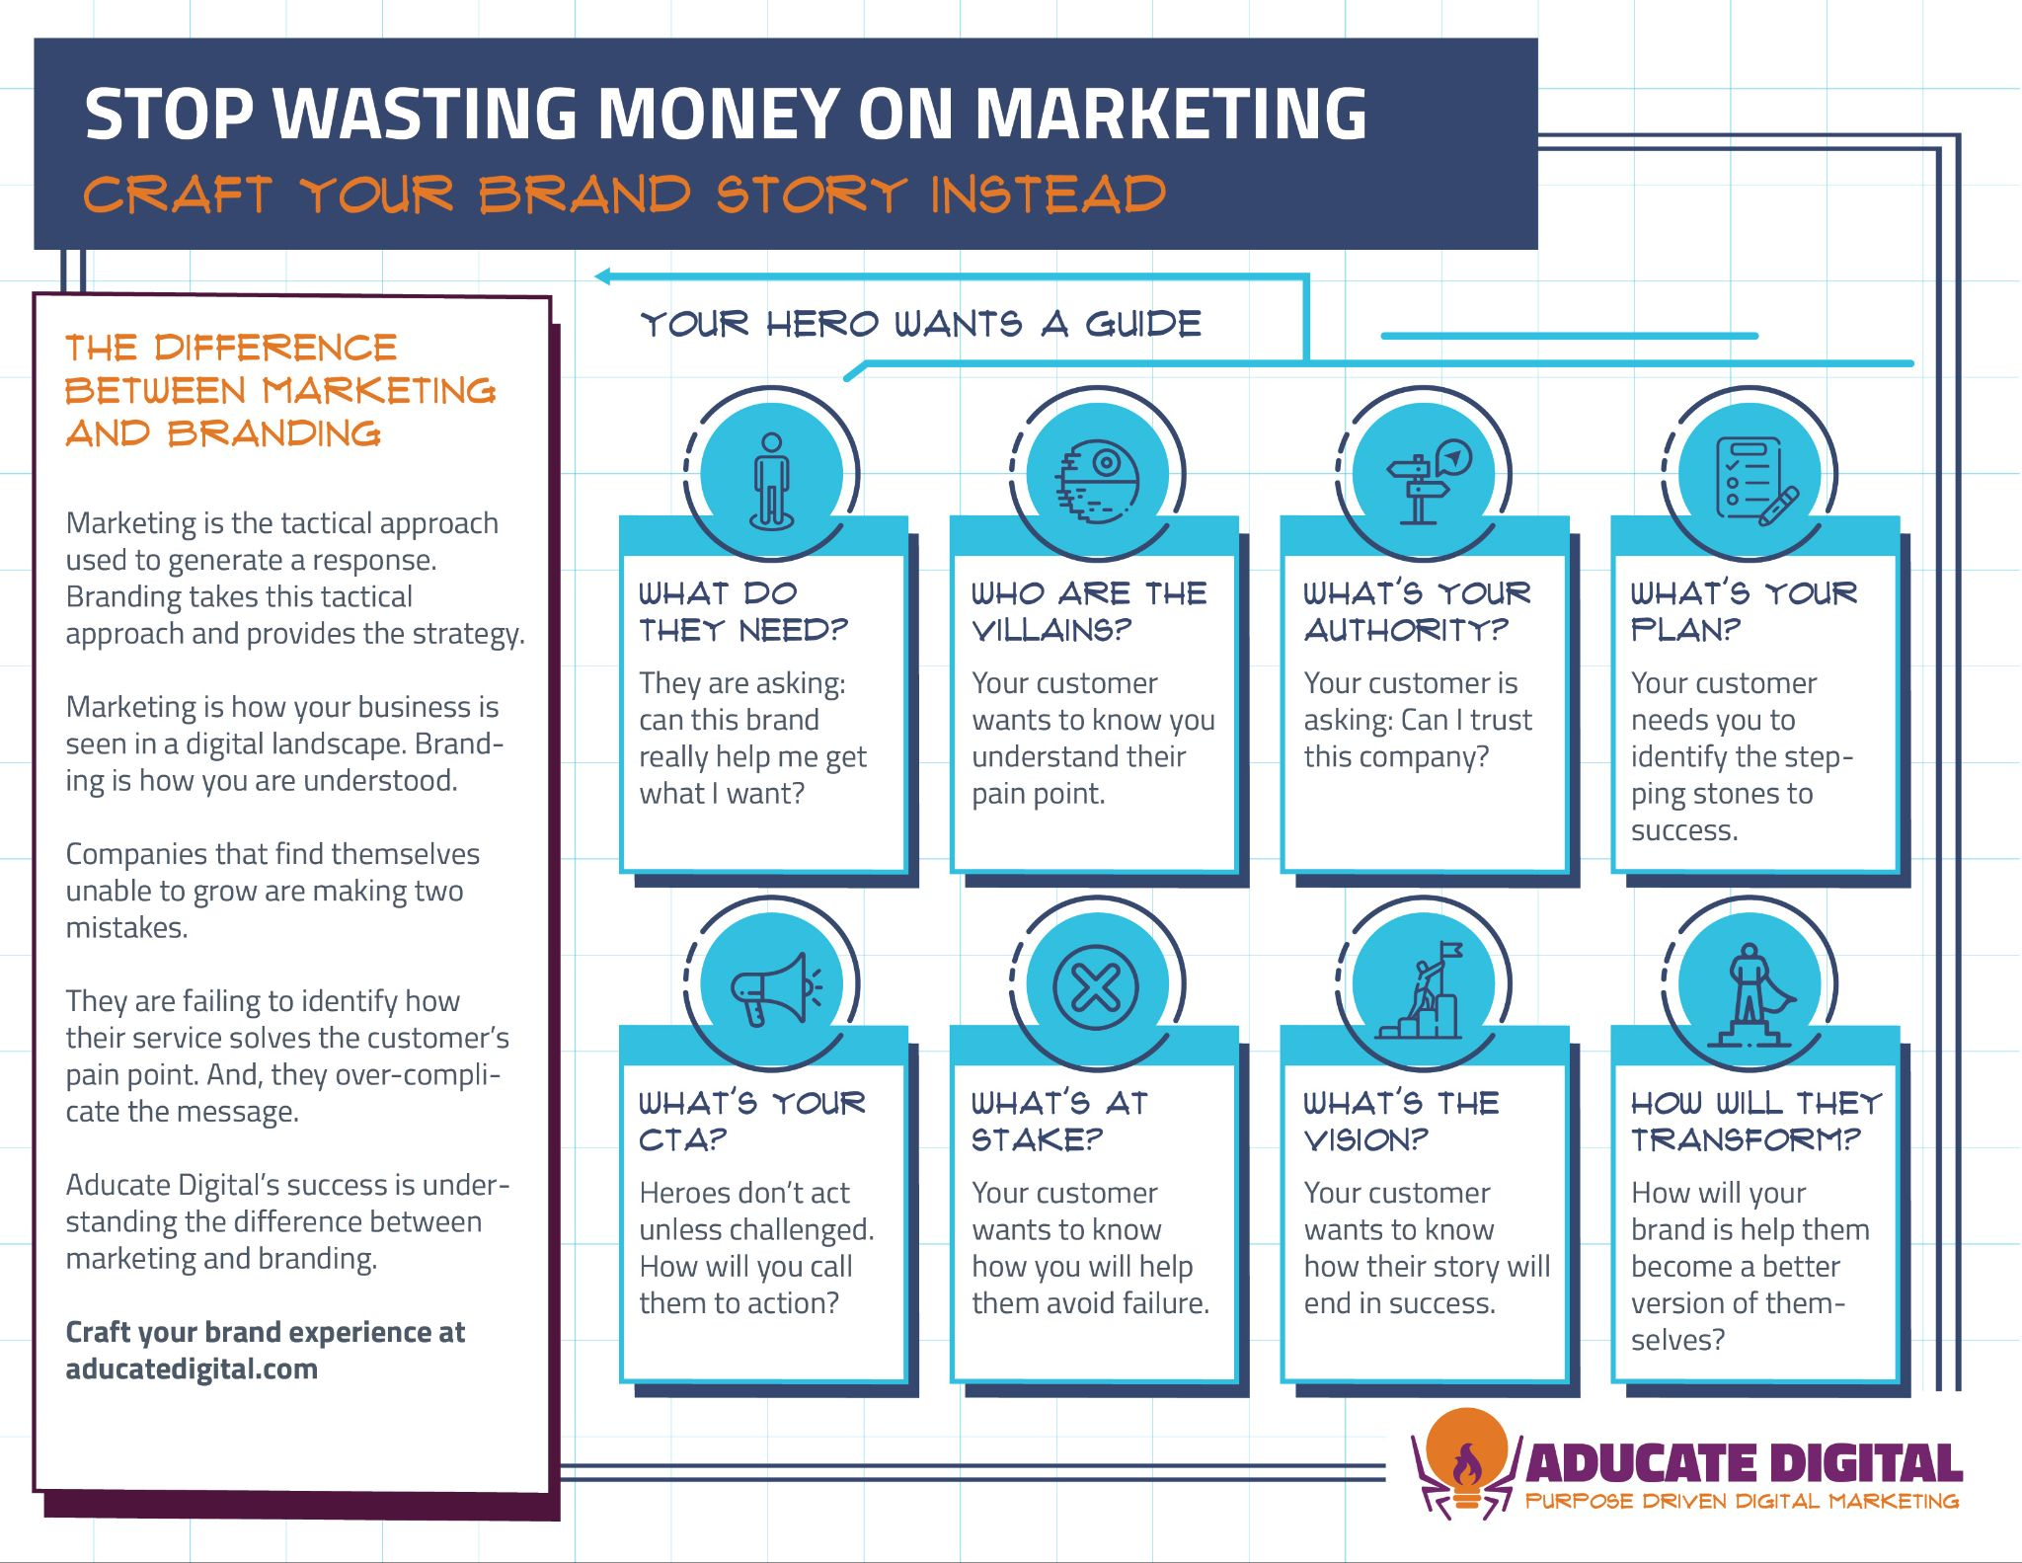
MARKETING RESOURCES!

Slide 34
Serving Clients
  A physical address in the state in which you operate (even if you are only doing in-home services) for billing purposes.
  A Tax ID # (and the IRS 575CP or 147C letter issued when your TIN was established).
  A Type 2 (Group) NPI
  A completed W9 form
  Professional and general liability insurance
  1-3 BCBAs to initiate a group contract request (depending on payor)
CONTRACTING & CREDENTIALING

Slide 35
Serving Clients
  BCBA certification and state license
  (if applicable in your state)
  Completed CAQH profile
  For some payors - CPR/BLS certification and background check
  Type 1 (Individual) NPI
EACH BCBA YOU CREDENTIAL WILL ALSO NEED:

Slide 36
GATHER DOCUMENTS
CONTRACTING
CREDENTIALING
COMPLIANCE
GETTING STARTED
GETTING PAID
PROCESSES VARY BY INSURANCE COMPANY
PROCESSING TIME CAN ALSO VARY WITHIN SAME PAYOR IN DIFFERENT STATES.
CONTRACTING TAKES AN AVERAGE OF 3-6 MONTHS*
CREDENTIALING TAKES AN AVERAGE OF 3-4 MONTHS*
*THESE ARE ESTIMATES

Slide 37
Serving Clients
WORKING WITH HEALTH INSURANCE
IS NOT LIKE WORKING WITH OTHER FUNDING SOURCES:
  Each payor has their own rules when it comes to clinical documentation, billing and reimbursement policies. Being out of compliance could mean audits and fines.
  Health insurance can contractually take 30-45 days to pay you - IF you do everything right. Billing errors on your part extend that timeframe.
  In most cases, it is unethical to discharge clients or pause treatment due to insurance non-payment.
HEALTH INSURANCE EXPECTATIONS

Slide 38
YOU WILL NEED A PLAN FOR OPERATING IN THE HEALTH INSURANCE SPACE

Slide 39
EDUCATE YOURSELF
ON PAYER PROCESSES
ROUTINE CHECKUPS
EACH PAYOR IS DIFFERENT AND POLICIES/PROCEDURES CHANGE OFTEN
FAMILIARIZE YOURSELF
SERVING CLIENTS RECAP
LEARN HOW TO NAVIGATE PAYOR WEBSITES
CONSIDER HIRING AN EXPERT
HEALTH INSURANCE IS CONFUSING AND TIME-CONSUMING

Slide 40



INSURANCE MANAGEMENT RESOURCES!
TLC Credentialing and Consulting offers PowerPoint presentations designed to help you better understand the requirements and nuances of working with health insurance. PowerPoints are available as stand-alone products or as part of a training package that comes with consulting services.

Slide 41
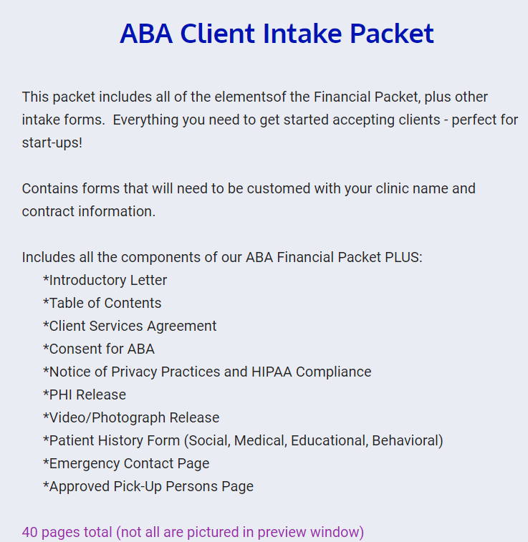
SPECIAL OFFER – NEW CLIENT INTAKE PACKET
Available here:
http://www.tlccredandconsulting.com/products/training-packages-3/
Use code STARTUP at checkout for 25% off of the ABA Client Intake Packet.
Valid 7/17/24-8/17/24

Slide 42
A TEAM OF TRUSTED ADVISORS
Surround yourself with experts and mentors. A strong team will support your growth and help you navigate challenges.
B.A.I.L. TEAM
BUSINESS & NETWORKING RESOURCES
Bookkeeper
Accountant
Insurance
Lawyer
SCORE Small Business Association
Women’s Business Center (WBCs)
Chamber of Commerce
Networking Groups

Slide 43
WE GOT YOUR BACK!
WE’RE HERE TO HELP YOU SUCCEED.
CANDACE WEBB
NICOLE KURTZ
Owner, TLC Credentialing
candace@tlccredandconsulting.com
https://www.tlccredandconsulting.com/
Owner, Aducate Digital
nicole@aducatedigital.com
https://www.aducatedigital.com

Slide 44

WE GOT YOUR BACK!
SCHEDULE A TIME TO CHAT WITH US.
Book a 30 minute 1-on-1 session
with Candace and Nicole.
July 24th from 9am-4:30pm CT
Sign Up Link

