Slide 1


Tricare West
Billing and Operations at a Glance

Slide 2
DISCLAIMER
This is a high-level overview of some of Tricare’s main billing and operational requirements. It is not all-inclusive and is only designed to be an introductory summary. It is recommended that you read the Tricare Operations Manual (TOM) in full. A link to the TOM, as well as links to other resources, is provided on the last slide.

Slide 3
Provider Requirements
Eligible provider types:
  Board Certified Assistant Behavior Analysts® (BCaBA®)
  Qualified Autism Service Practitioner – Supervisors (QASP-S®)
  Licensed assistant behavior analysts (LABA), and/or
  Behavior technicians (BTs), including:
    Registered Behavior Technicians® (RBT®)
    Applied Behavior Analysis Technicians® (ABAT®)
    Board Certified Autism Technicians (BCAT)
    State-certified BTs where applicable
All providers must pass a Tricare-compliant background check (10 year look back, national and state criminal and sex offender registry)
All BTs must be RBTs
All providers must be CPR or BLS certified
  The certification course MUST contain an in-person component

Slide 4
Tricare Credentialing at a Glance
Two levels of Providers
  Tricare “Certified”
  Tricare Network Provider
RBTs only get Tricare Certified. They are not eligible for full credentialing, but once they are certified and linked to an in-network group, they are considered in network
BCBAs must be both Tricare Certified and credentialed as a Network Provider
  BCBAs who are Tricare Certified but not credentialed are considered out of network
Tricare will not accept claims from providers that are not at least Tricare Certified

Slide 5
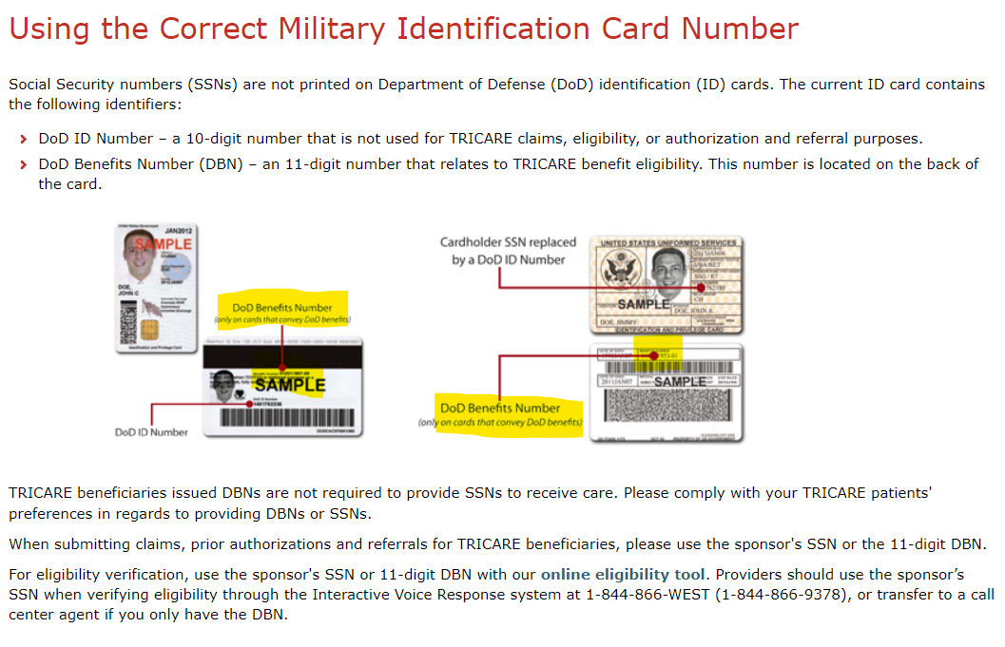
Tricare ID Card At A Glance

Slide 6
Tricare Billing at A Glance
Must bill with the rendering provider who actually rendered the service (the BCBA or RBT) under that provider’s NPI
Does not use HO, HM, HN Modifiers
Uses 9 codes
  Does not cover 97152 or 97154
  97156 is the only code covered for telehealth
Session times must be listed on claims, in military time

Slide 7
97151(Behavior Identification Assessment)
Rendered by BCBA or BCaBA
Initial assessments are approved for 32 units for the auth period. Assessment must be completed within 14 calendar days from the first date of service.
  If you start 97151 on 4/1/24, all 32 units must be used by 4/15/24. Units billed on dates of service after 4/15/24 will not be reimbursed.
Re-authorization assessments are approved for 24 units.
Approved units include the administration, scoring and analysis of PDDBI
No telehealth allowed.

Slide 8
97153 (Adaptive Behavior Treatment By Protocol)
If rendered by an RBT, bill under the RBT’s NPI
May not exceed 32 units (8 hrs) per day or 160 units (40 hrs) per week
The weekly units authorized for CPT code 97153 cannot be rolled over to other weeks. The week is defined as Sunday to Saturday.
No telehealth allowed.
If rendered in the school setting:
  Rendered by authorized ABA supervisors only.
  Must be approved through the clinical necessity review process.
  Services are focused, time-limited, and in accordance with the requirements of the ACD

Slide 9
97155 (Adaptive Behavior Treatment by Protocol Modification)
Rendered by BCBA or BCaBA
At least one session per month must be rendered by the authorized ABA supervisor and cannot be delegated to an assistant behavior analyst.
  Providers are subject to a 10% penalty on all ABA claims for a beneficiary’s entire six-month authorization if not met.
  Ten percent penalty may be waived if no CPT code 97153 services were rendered within the calendar month
Cannot bill for team meetings or IEPs
No telehealth allowed
Maximum of 8 units (2 hrs) per day

Slide 10
97156 (Family Adaptive Behavior Treatment Guidance)
Rendered by BCBA or BCaBA
May not exceed 8 units (2 hrs) per day
ABA providers must render the first session of parent training (CPT codes 97156 or 97157) within 30 calendar days of each treatment authorization.
Six parent/caregiver sessions every six months (CPT codes 97156 and/or 97157).
After first six-month authorization period, may be rendered via telehealth if authorized

Slide 11
97157 (Multiple Family Group Adaptive Behavior Treatment Guidance)
Rendered by BCBA or BCaBA
May not exceed 6 units (1.5 hrs) per day and 8 participants per group. May only be used in an office/clinic setting.
ABA providers must render the first session of parent training (CPT codes 97156 or 97157) within 30 calendar days of each treatment authorization.
Six parent/caregiver sessions every six months (CPT codes 97156 and/or 97157).
Telehealth not allowed

Slide 12
97158 (Group Adaptive Behavior Treatment by Protocol Modification)
Rendered by BCBA or BCaBA
May not exceed six units per day and eight participants per group.
Telehealth not allowed

Slide 13
Covered Places of Service
02 (Telehealth)
03 (School)
11 (Office/Clinic)
12 (Home)
99 (Other) – non-school daycare, community setting

Slide 14
Modifiers
HR – Family/couple with client present
HS – Family/couple without client present
GT or 95 – Parent/caregiver remote sessions (telehealth)
99 – Use with 97151 to identify outcome measures (Vineland-3, SRS-2, PSI-4-SF/SIPA)

Slide 15
Concurrent Billing – Bottom Line
Cannot bill 97151 and 97155 at the same time
Cannot bill 97153 and 97155 at the same time
CAN bill 97155 and 97156 at the same time
CAN bill 97153 and 97156 at the same time
CAN bill 97151, 97153 and 97156 at the same time
CAN bill 97157 and 97158 at the same time

Slide 16
Concurrent Billing - Details
97153 and 97155: Concurrent billing is not permitted. Only one CPT code should be billed when concurrent care services are performed.
97153 and 97156: Concurrent billing is permitted if the BT, assistant behavior analyst or ABA supervisor is working with the beneficiary (CPT code 97153) and the ABA supervisor or a different ABA supervisor or assistant behavior analyst is conducting parent training (CPT code 97156) and the beneficiary is not present.
97155 and 97156: Concurrent billing is permitted if the authorized ABA supervisor or assistant behavior analyst is working with the beneficiary (CPT code 97155) with or without the BT present and a different ABA supervisor or assistant behavior analyst is conducting parent/caregiver training (CPT code 97156), and the beneficiary is not present.
97151 and 91753 or 97156: Concurrent billing is permitted if the authorized ABA supervisor or assistant behavior analyst is completing an element of the assessment (for example, direct time, report writing) under CPT code 97151 and a different ABA supervisor, assistant behavior analyst, or BT is rendering CPT codes 97153 or 97156. The beneficiary can only be present for one code.
97157 and 97158: Concurrent billing is permitted if the authorized ABA supervisor has delegated CPT code 97157 to the assistant behavior analyst who is facilitating the parent group while the authorized ABA supervisor renders CPT code 97158 with a group of beneficiaries.

Slide 17
Progress Note Requirements
This list is not all-inclusive. Please review TRICARE Operations Manual (TOM), Chapter 18, Section 4 and TRICARE Policy Manual (TPM), Chapter 1, Section 5.1 for complete details.
Beneficiary’s full name
Date, time (start/end time), length of session
Location of rendered services
Names of session participants
Rendering provider’s name and license or certification
Dated signature (Important: The dated signature requirement refers to the date the progress note was signed and may differ from the date listed for the session date requirement. Dates must be entered for both requirements.)
Full name of authorized ABA supervisor (if different than the rendering provider)
Beneficiary’s current clinical status (as observed at the beginning of each session)
Narrative summaries of session content to include details per Current Procedural Terminology (CPT®) code
ABA techniques attempted, response to treatment, and progress toward treatment goals

Slide 18
Annual Provider Training
All ABA Groups and Solo BCBAs must complete annual training:
  https://www.tricare-west.com/content/hnfs/home/tw/prov/autism-care-demonstration/annual-provider-training.html

Slide 19
Further Reading
Tricare West Autism Care Demonstration Page
  https://www.tricare-west.com/content/hnfs/home/tw/prov/autism-care-demonstration.html
Tricare Operations Manual (TOM)
  https://manuals.health.mil/pages/DisplayManual.aspx?SeriesId=OPERATIONS
ABA Service Settings
  https://www.tricare-west.com/content/hnfs/home/tw/prov/autism-care-demonstration/aba-service-locations.html
Treatment Plan Requirements
  chrome-extension://efaidnbmnnnibpcajpcglclefindmkaj/https://www.tricare-west.com/content/dam/hnfs/tw/prov/resources/pdf/ACD%20Treatment%20Plan%20Requirements.pdf

